Slide 1

www.iaac.us | 212.594.3685
Indo-American Arts Council
New York Indian Film Festival (NYIFF)
The Annual
Indo-American Arts Council
Film Festival
OPENING NIGHT GALA | SCREENINGS | INDUSTRY PANELS | CLOSING NIGHT AWARDS

Slide 2
Indo-American Arts Council
Mission Statement
The Indo-American Arts Council (IAAC) is a secular, not-for-profit service and resource arts organization, charged with the mission of promoting the awareness, creation, production, exhibition, publication and performance of Indian and cross-cultural art forms in North America.
Over the past decade the IAAC has created specific programming to promote Indian Art, Literature, Dance, Fashion, Film, Music and Theatre with over 200 events. Events include:
    Salman Rushdie’s Launch of “Shalimar the Clown”
    Chandrika Tandon’s Grammy award nominated CD Launch
    Shashi Tharoor's launch of his book Riot
    Tendulkar festival (theatre, film, discussion)
    Perspectives of Gandhi (discussion, film, theatre)
    Global Runway's Night Out (fashion show featuring top International designers)
    Erasing Borders Annual Festival of Indian Dance
    Erasing Borders Annual Exhibition of Contemporary Indian art of the Diaspora
    Mallika Sarabai's Hot Talas Cool Rasas (dance)
    * Annual Playwrights Festival
    “…Promoting Indian Art & Artists in North America since 1998…”

Slide 3
IAAC Film Festival Overview
Largest, most prestigious South Asian Film Festival in North America
  Independent, art house, alternate, and diaspora feature films, documentaries and short films
  Provides emerging filmmakers an opportunity to tell their stories, meeting financiers and forge distribution relationships
Initiated in 2001 in response to Mayor Giuliani’s call to resuscitate New York City by energizing New Yorkers after the shock and horror of the 9/11 attack
  First festival opened with Merchant Ivory’s Shakespearewallah and Closed with Mira Nair’s Monsoon Wedding
  -Other notable premieres include Danny Boyle’s Slumdog Millionaire, Mira Nair’s Namesake, Deepa Mehta’s Midnight’s Children, Mani Ratnam’s Raavan, Shyam Benegal’s Well Done Abba, Anurag Kashyap’s Gulaal, Sudhir’s Yeh Sali Zindagi.
  Five days of red carpet gala screenings, nightly networking parties, industry panels, post-screening discussions, amazing media & industry attention, overflowing with audiences and celebrities, an award ceremony and numerous special events.

Slide 4
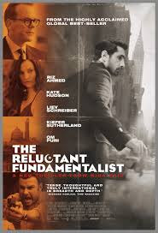

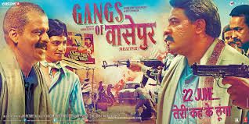

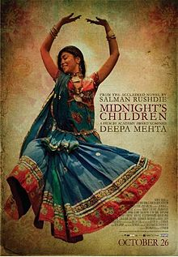
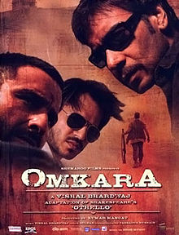
Film Festival Growth
Rapid growth since 2001
  Film Premieres include
    Danny Boyle’s Slumdog Millionaire
    Mira Nair's Namesake, Amelia, Monsoon Wedding, The Reluctant Fundamentalist
    Deepa Mehta’s Earth, Water, Heaven on Earth, Midnight’s Children
    Mani Ratnam’s Ravanan
    Vishal Bhardwaj's Omkara
    Shyam Benegal’s Well Done Abba
    Anurag Kashyap’s Gulal, Gangs of Wasseypur
    Sudhir Mishra’s Tera Kya Hoga Johnny
    Aparna Sen’s The Japanese Wife, Iti Mrinalini
    Santosh Sivan’s Tahaan
    Deepti Naval’s Do Paise Ki Dhoop…
    Hansal Mehta’s Shahid
    Rituparno Ghosh’s Dosar, Chitrangada

Slide 5
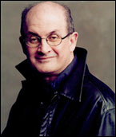
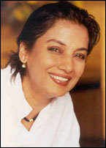
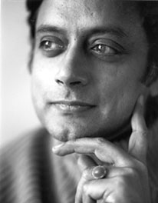

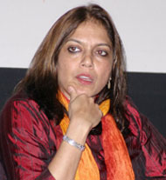
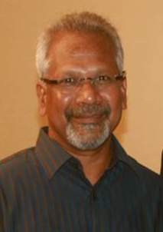
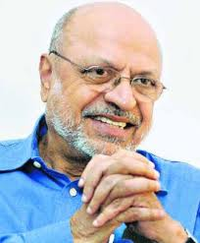

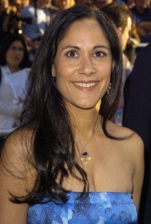
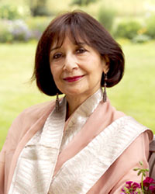
Film Festival Advisory Committee
The IAAC Film Festival is proud to have a strong and active advisory committee supporting the leadership team filmmakers, actors and the festival
Deepa Mehta
Mira
Nair
Salman Rushdie
Shabana Azmi
Shashi Tharoor
Mani Ratnam
Shyam
Benegal
Sabrina
Dhawan
Sakina Jaffrey
Madhur Jaffrey
IAAC Advisory Committee members include Pervez Sharma and Satish Kolluri, Robert Browning, Gerson de Cunha, Uma de Cunha, Mahesh Dattani, Vishakha Desai, Wynn Handman, Ustad Amjad Ali Khan, Veena Advani, Nari Pohani, Rajika Puri, Zeyba Rahman, Indur Shivdasani, Sundaram Tagore, Dr. Murali Doriaswamy, Jane Gullong, Mallika Sarabhai, Neelam Deo, Tino Puri, Chandrika Tandon, Yakub Mathew, Priyanka Mathew, Dilip Advani, Dr. Sunil Kothari, Suketu Mehta.

Slide 6



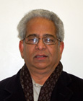

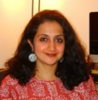
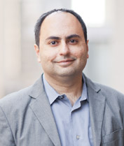
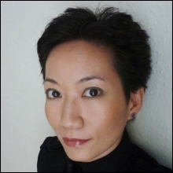


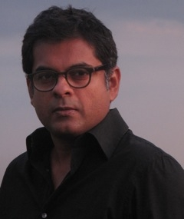

Festival Award Jury – NYIFF 2013
Myrna
Moncayo-Iyengar
Ashish Avikunthak
Parag
Amladi
Udayan Gupta
Nilita Vachani
Tejaswini Ganti
Muriel Peters
JJaideep
Punjabi
La Frances
Hui
Claus Mueller
Zenobia Shroff
Joseph Mathew

Slide 7
Festival Staff
Aroon Shivdasani, Artistic & Executive Director, IAAC
Aseem Chhabra, Film Festival Director
Anjali Manjam, Development Director
Milan Mantri, Volunteer Coordinator
Vasanti Mirchandani, Director of Hospitality
Thomas Kelso, Accountant
Swati Pophaly, Outreach Program Manager
Sehyr Bains, Executive Assistant
Sushanti Bordoloi, Submissions Coordinator

Slide 8
Aroon Shivdasani
Executive Director and founding member of the Indo-American Arts Council, Aroon is passionate about its mission to build an awareness of Indian artists and artistic disciplines (performing, visual, literary and folk arts in North America). She is equally passionate about nurturing and promoting emerging artists in all the disciplines from the Indian subcontinent.
Aroon sits on the Boards of the Queens Museum of Art, The Museum Trustees Assoc. and The Lark Play Development Company as well as the Advisory Boards of several other art and charity organizations, as well as the juries of the Emmys, beauty contests, grants, art, film and theatre contests.
She has received numerous awards and recognition from various groups including:
  Outstanding Citizen awards from the City of New Rochelle, NY in 1988 "for the organization and execution of a French Fete to commemorate the 200th anniversary of New Rochelle";
  The NY State Assembly in 2001 "for working to build an awareness of Indian artistic disciplines in New York City, to raise money & social consciousness for domestic violence victims, earthquake victims and the victims of AIDS";
  The City Council, NYC in 2002,"for exemplary service to the community";
  An Honor & Appreciation award from the Gathering International Health Professions Network, Greater Hudson Valley "for untiring efforts to serve the community" ;
  Children’s Hope Award in 2010 “in recognition of your passionate efforts to bring Indian Arts and Culture to America through the IAAC”.

Slide 9
Aseem Chhabra
Film Festival Director of the Indo-American Arts Council, Aseem has also been involved for many years in various capacities for programming films from the Indian Subcontinent for a number of film festivals in the US.
Aseem is also a freelance writer in New York City who writes on a variety of topics, including arts, entertainment, social and political issues stories. Aseem has been published in The New York Times, The Boston Globe, The Philadelphia Inquirer and The Courier-Journal, Time Out, New York. He writes a weekly column for Mumbai Mirror – a Mumbai based daily newspaper and also contributes regularly to two Indian-American outlets -- India Abroad and Rediff.com, the leading news portal that originates from Mumbai. His by-lines have also appeared in India in Outlook, and the Indian editions of People and Cosmopolitan magazines.
Aseem has been interviewed on film and popular culture by several media outlets, including ABC’s Good Morning America and Nightline, National Public Radio, CNN, Associated Press, Reuters, The Los Angeles Times and New York Daily News.
Aseem is an elected member of the board of the South Asian Journalists Association and the New York Chapter coordinator of SAJA, where he often chairs panel discussions on social and political issues, hosts book reading events and other arts discussions.

Slide 10
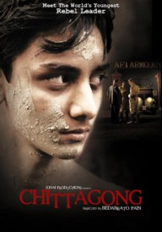
2013 Festival Overview
Opening night Red Carpet premiere of Feroz Abbaz Khan’s Dekh Tamasha Dekh at Skirball Center of the Performing Arts, New York City
Gala Benefit Dinner at the Skirball Center for Performing Arts, New York City.
Centerpiece Screening of Hansal Mehta’s Shahid at Tribeca Cinemas followed by Film Festival Party
Closing Night Red Carpet Screening of Nitin Kakkar’s Filmistaan followed by the Award Ceremony and the Closing Night Reception
Full day of FILMINDIA Industry Panels with film-makers, industry insiders and actors
5 Days
Over 55 Films
Over 5,000 Attendees
20+ Films Sold-out
Industry Panels
Networking Parties

Slide 11
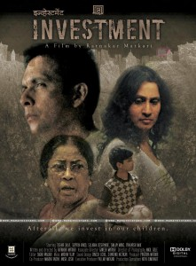
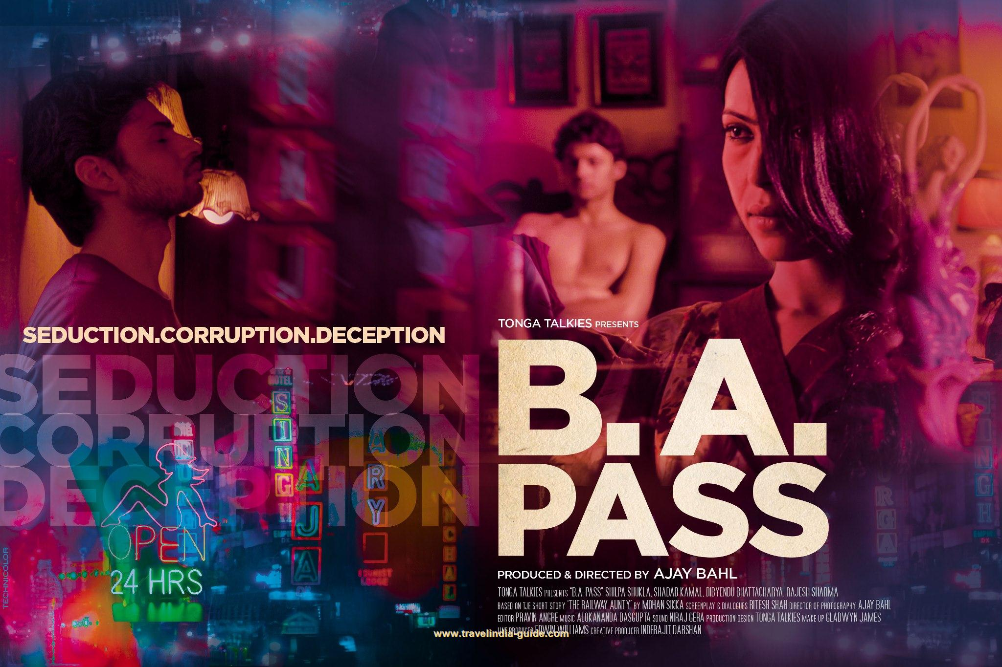
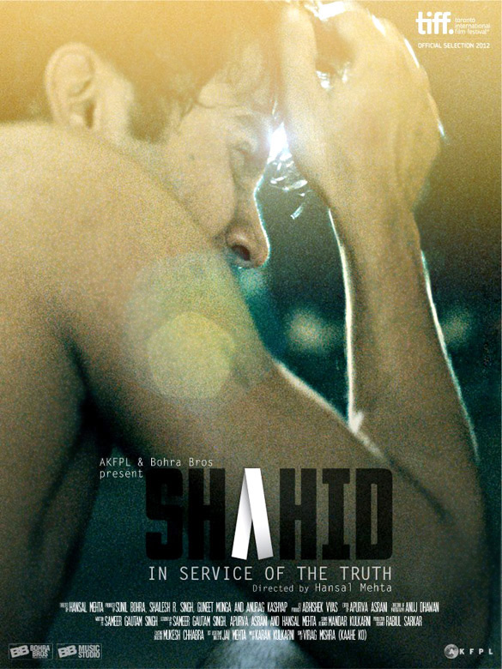
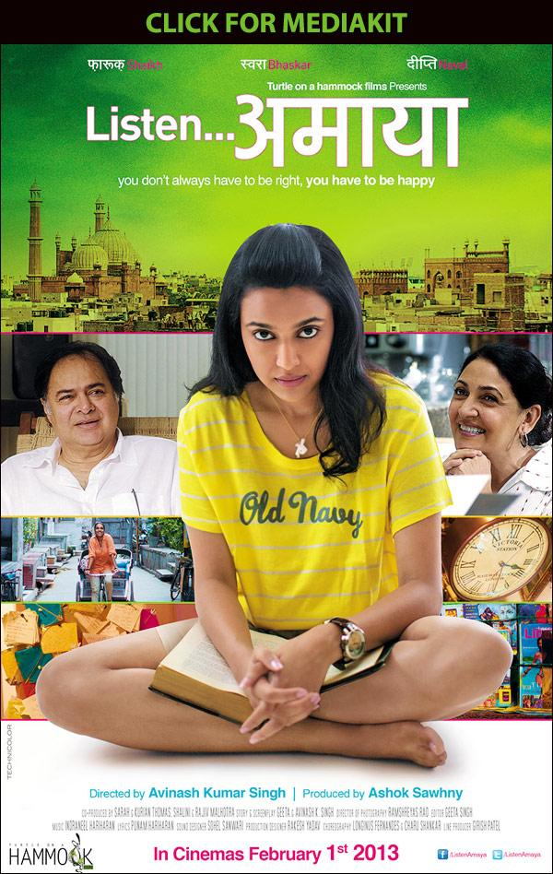
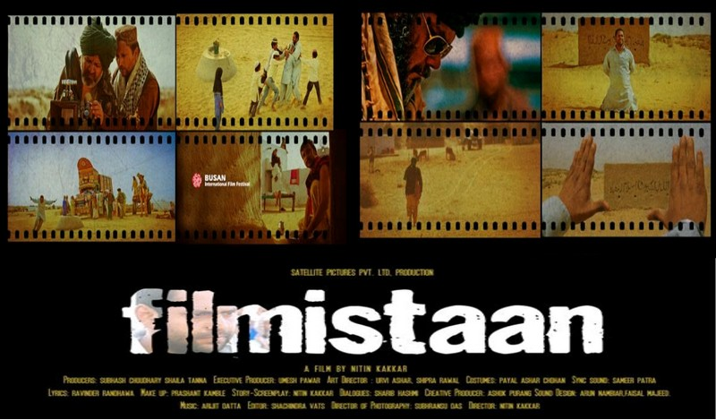
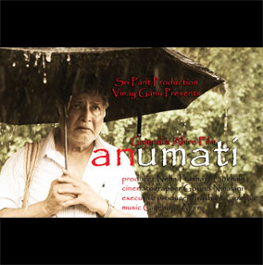
2013 Notable Films

Slide 12
Audience
Over 5,000 attendees from a diverse range of occupations and age groups across New York
Critical mass of audience members between 25-34 and from the Entertainment, Media, Finance, Healthcare and Technology Industries
IAAC applies a targeted marketing approach to reach specific audience groups both within and outside the South Asian Community
A strong base of returning audience members and over 50% new audience members

Slide 13
Partners and Collaborators
In addition to the audience that attends the festival, IAAC has partnered with various local organizations to broaden our message and reach. Organizations we have partnered with include:
SAJA (South Asian Journalists Association)
AIF (America India Foundation)
SAKHI
CRY (Child Relief and You)
Bharatiya Vidya Bhavan
Asia Society
AIA (Association of Indians in America)
NetIp (Network of Indian Professionals)
TiE (The Indus Entrepreneurs)
GOPIO (Global Organization of People of Indian Origin)
City Opera
Sundaram Tagore Gallery
Aicon Gallery
World Music institute
Engendered
IIT, US alumni (Indian Institute of Technology)
Lincoln Center Film Society
Rubin Museum
Queens Museum of Art
Newark Museum
Metropolitan Museum
MOMA
Manhattan Theatre Club
Lark Theatre
The Play Company
The Guild Art Gallery

Slide 14
Festival Reviews
“It's wonderful to have an Indian film festival here [in New York] and wonderful to have a Tamil film screened here on the 10th year [of IAAC].” – Mani Ratnam
“It's just been very pleasurable to see how it's grown to become a very serious thing and I think now they get the best films, it gets a lot of media attention and I think it's a fantastic platform, both for Indian filmmakers from the US and from India.” – Salman Rushdie
“I'm here to celebrate IAAC…to celebrate this wonderful dynamo of a woman, Aroon Shivdasani, who started in the bedroom and has now gone to the boardroom.” – Mira Nair
“I really admire the work Aroon Shivdasani is doing. I think she works tirelessly for the arts and culture, not only for the Indian diaspora but just for the life of the city of New York” – Padma Lakshmi
“IAAC is uncompromisingly of the alternative stream that plays directly into what I love and so I'll always support this... as long as they keep their artistic integrity, I’m right here.” – Rahul Bose
“The fact that it's been 10 years is incredible because the programming has been continuously getting better and better” – Samrat Chakrabarti
“The IAAC film festival has become one of the most important cultural events on the calendar of the Indian-American community” – Prabhu Dayal (Indian Consul General in New York)

Slide 15

2014 Film Festival
14th Annual NEW YORK INDIAN FILM FESTIVAL (NYIFF) will be from May 5th-10th 2014.
Opening night Red Carpet premiere at Skirball Center for Performing Arts followed by the Gala Benefit Dinner.
Centerpiece Screening at Tribeca Cinemas followed by Film Festival Party
Closing Night Red Carpet Screening followed by the Award Ceremony at Skirball Center for Performing Arts and the Closing Night Reception.
6 Days
Over 5,000 Attendees,
Networking Parties, Red Carpet Galas Receptions
Over 50 Films
Industry Panels
Special Events
Award Ceremony

Slide 16

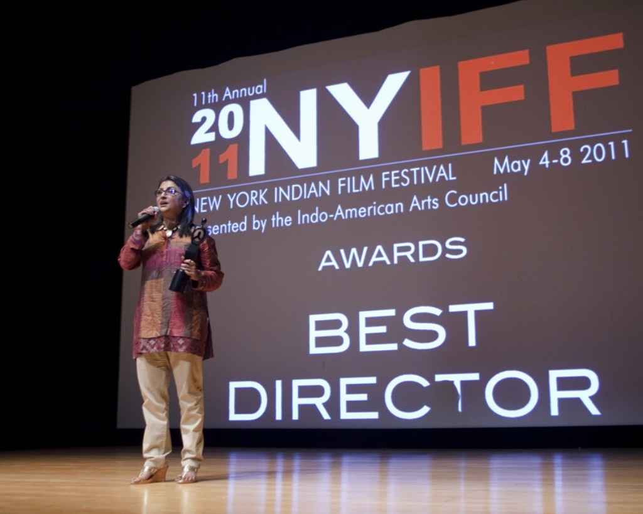
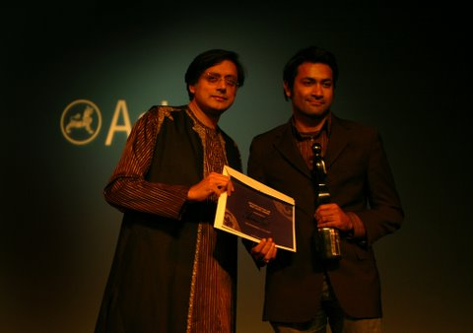
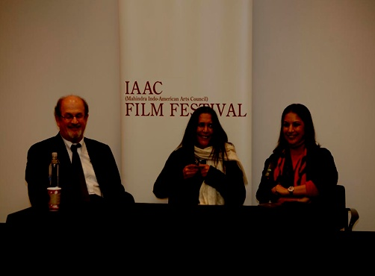
SPONSORSHIP
Notes:
Change shashi pic for one with mira and award

Slide 17
Past Sponsors
Aha Designs
Amrita Design
Asia Society
AVS
Air India
Aicon Gallery
At Vermilion
Benaras Restaurant
Breakthrough
Cearar Productions
Consulate General of India
Continental Airlines
Design Archives
Desiclub.com
Desi You
Desi hits
Dish Network
Divya
El Dorado rum
Eros International
Enterntainment Partners
EMRG Media
Elite
Filmy
Flo Vodka
Good Earth Winery
HBO
HSBC Premier
Incredible india
India Aboard
Jet Airways
Kingfisher Airlines
KPMG
Lotus Visual
Lasso with Lavina
Mela
Misha Nicole

Slide 18
Past Sponsors
Mahindra
Mirza Ghalib Wines
Museum of Moving Images
NFDC
New York State Council for the Arts
National Endowment for the Arts
New York Times
NYU Tisch
Nelson Mandela Foundation
NYU
New York Film Academy
Paramount Hotel
Qatar Airways
Piakaghar
Radisson Hotel
Reliance Global Call
Rediff.com
Reliance Global Call
Sa Re Ga Ma
Sahara One
Samma
Say We
Showbiz India
Sa Re Ga Ma
Signs by Tomorrow
Saavn
Sampurn media
TV Asia
Teatulia
Taj Hotels Resorts and Palaces
Tulsi
The Cake Designer
UB Group
Whistling Woods
Wells Fargo

Slide 19
Sponsor Opportunity
IAAC partners with select organizations whose objectives align with those of the Film Festival thereby engaging and nurturing long-term mutually beneficial and culturally rich relationships
As the festival continues to grow, it becomes an increasingly formidable marketing platform for partners and organizations to garner targeted exposure
  Provides access to the Indian diaspora in the entire East Coast market
  Opportunity for an international brand to establish and entrench itself amongst North American consumers
  Targeted marketing to specific income, occupation and gender based groups
  Association with brands of a distinguished caliber and recognizable talent who regularly support and participate in the festival
  Recognition for involvement and support in developing the arts and culture of New York City
  Reach an IAAC mailing list of 68,000 arts aficionados.
  The IAAC is a 501(c)(3) tax-exempt organization. All donations are tax-deductible to the fullest extent allowable by law.

Slide 20
Sponsorship and Branding
Marketing benefits associated with the festival include:
Effective brand development and visibility
Showcases social and community responsibility
On-site corporate hospitality and benefits
Networking with co-sponsors, developing corporate relationships
Media exposure
Signage
Promotional presence on website and collateral materials
Networking opportunities with celebrities
Interaction with members of the US and Indian entertainment industries
Right to promote / co-brand

Slide 21
Press & Media Coverage
The festival brings together a collection of indie films as well as better-known Bollywood fare. More than half the films are screening for the first time or making their U.S. debuts. – The Wall Street Journal
It could become the Indian counterpart to Sundance. This year's NYIFF still features Indian independent and Diaspora films, but each year it's getting to be bigger, better and more exciting than the last! -- Yahoo News India
With film festivals dedicated to Indian cinema popping up all over the U.S., the granddaddy of them all, Indo-American Arts Council has upped its game with a new moniker, an earlier date and writer Aseem Chhabra as its festival director. – Daily Variety
Capping off five days of Indian cinematic excellence, the prestigious festival concluded on Sunday night with the spectacular closing night red carpet premiere of Rituparno Ghosh's powerful film Noukadubi at the Asia Society in Manhattan. -- Hindustan Times
Not all of Indian cinema is associated with Bollywood. And the Indo-American Arts Council’s 11th annual New York Indian Film Festival, going on from May 4 to 8, is the place to get a real feel for the independent and social aspects of Indian film in New York. It may not be all singing and dancing, but there will definitely be some at the festival’s red carpet events and after parties. – Audrey Magazine
Born in the shadow of 9/11 and conceived by the Indo-American Arts Council, the festival, now in its 11th year, has grown from a two-day showcase for a handful of features to this year’s five-day feast of 25 feature films (many U.S. or New York premieres) and 22 shorts, including both documentaries and fiction films. The only kind of filmmaking conspicuous by its absence is the Bollywood spectacle. – Film Journal International
This film festival wasn’t in Cannes, but it didn’t lack for celebrities and glamor. It wasn’t in Sundance either, but the festival did have serious, well-crafted dramas that would please cinephiles. – Khabar

Slide 22
Sponsorship Levels
Sponsorship levels range from $10,000 - $250,000. Details on specific benefits can be provided upon request. Sponsorship packages may be tailored to specific sponsor requirements.
  Diamond Exclusive Sponsorship – $250,000
  Emerald Sponsorship – $150,000
  Ruby Sponsorship – $50,000
  Sapphire Sponsorship – $25,000
  Amethyst Sponsorship – $15,000

Slide 23

New York Indian Film Festival (NYIFF)
The Annual Indo-American Arts Council Film Festival
www.iaac.us
© Indo-American Arts Council, Inc.

